Slide 1
Project Presentation of Industry Oriented Hands on Experience (22CS422)
On
NexsusHR
Divanshu Garg – 2210990289
Prajwal - 2210992057
Supervised By
Dr. Gurpreet Singh
Department of Computer Science and Engineering,
Chitkara University, Punjab

Slide 2
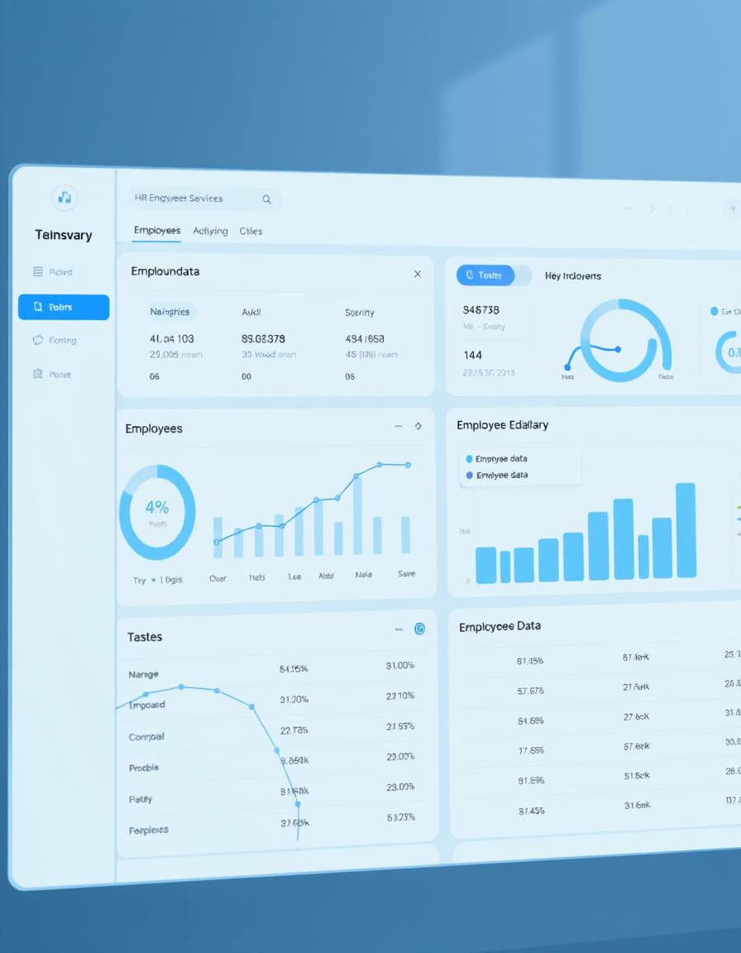
Introduction
The Employee Management System is a complete solution designed to help organizations manage their employees and internal structure more efficiently. It provides a centralized platform where admins can onboard new employees, create and manage departments, define roles, and monitor attendance and timesheets. The system includes separate login portals for admins and employees, ensuring that each user accesses the features relevant to their role.
Built using Node.js, Express.js, Prisma, and PostgreSQL, the backend handles authentication, authorization, and database management securely. The frontend offers a simple and clear interface where admins can manage operations easily, and employees can log in to view their details and update their timesheets. This system helps reduce manual work, improve coordination, and bring transparency to the overall employee management process.

Slide 3
Problem Statement
Modern organizations face significant challenges in efficiently managing employee attendance, ensuring compliance with company policies and labor laws, and integrating attendance data with payroll and leave management systems. Manual attendance processes are prone to errors, time theft (such as buddy punching), and lack transparency for both employees and management. This leads to inaccurate payroll calculations, reduced productivity, and increased administrative workload for HR teams.
There is a need for a secure, automated, and user-friendly Employee Management System that enables:
Accurate and real-time attendance tracking (via web, mobile, or biometric methods),
Role-based access and self-service for employees, HR, and administrators,
Seamless integration with leave and payroll management,
Automated reporting and compliance with labor regulations,
And transparent dashboards for both employees and management.

Slide 4
Key Functionalities
Authentication & Authorization: Secure login system with role-based access control for Super Admin, Sub Admin, and Employee roles.
Employee Onboarding: Allows admins to add new employees, assign roles, and link them to departments during onboarding.
Role & Department Management: Create, update, and organize roles, departments, and positions across the organization.
Separate Portals: Dedicated login interfaces for admins and employees to ensure personalized access and functionality.
Timesheet & Attendance Tracking: Manage weekly and daily timesheets with approval workflows for better attendance monitoring.
Employee Profile Management: Employees can view and update their personal and professional details.
Entity Control: Soft-delete, activate, or deactivate users, roles, and departments as needed.
Database Management: Uses Prisma ORM with PostgreSQL for efficient and secure data handling.
Access Levels: Granular access permissions for different user roles to maintain data integrity and security.

Slide 5
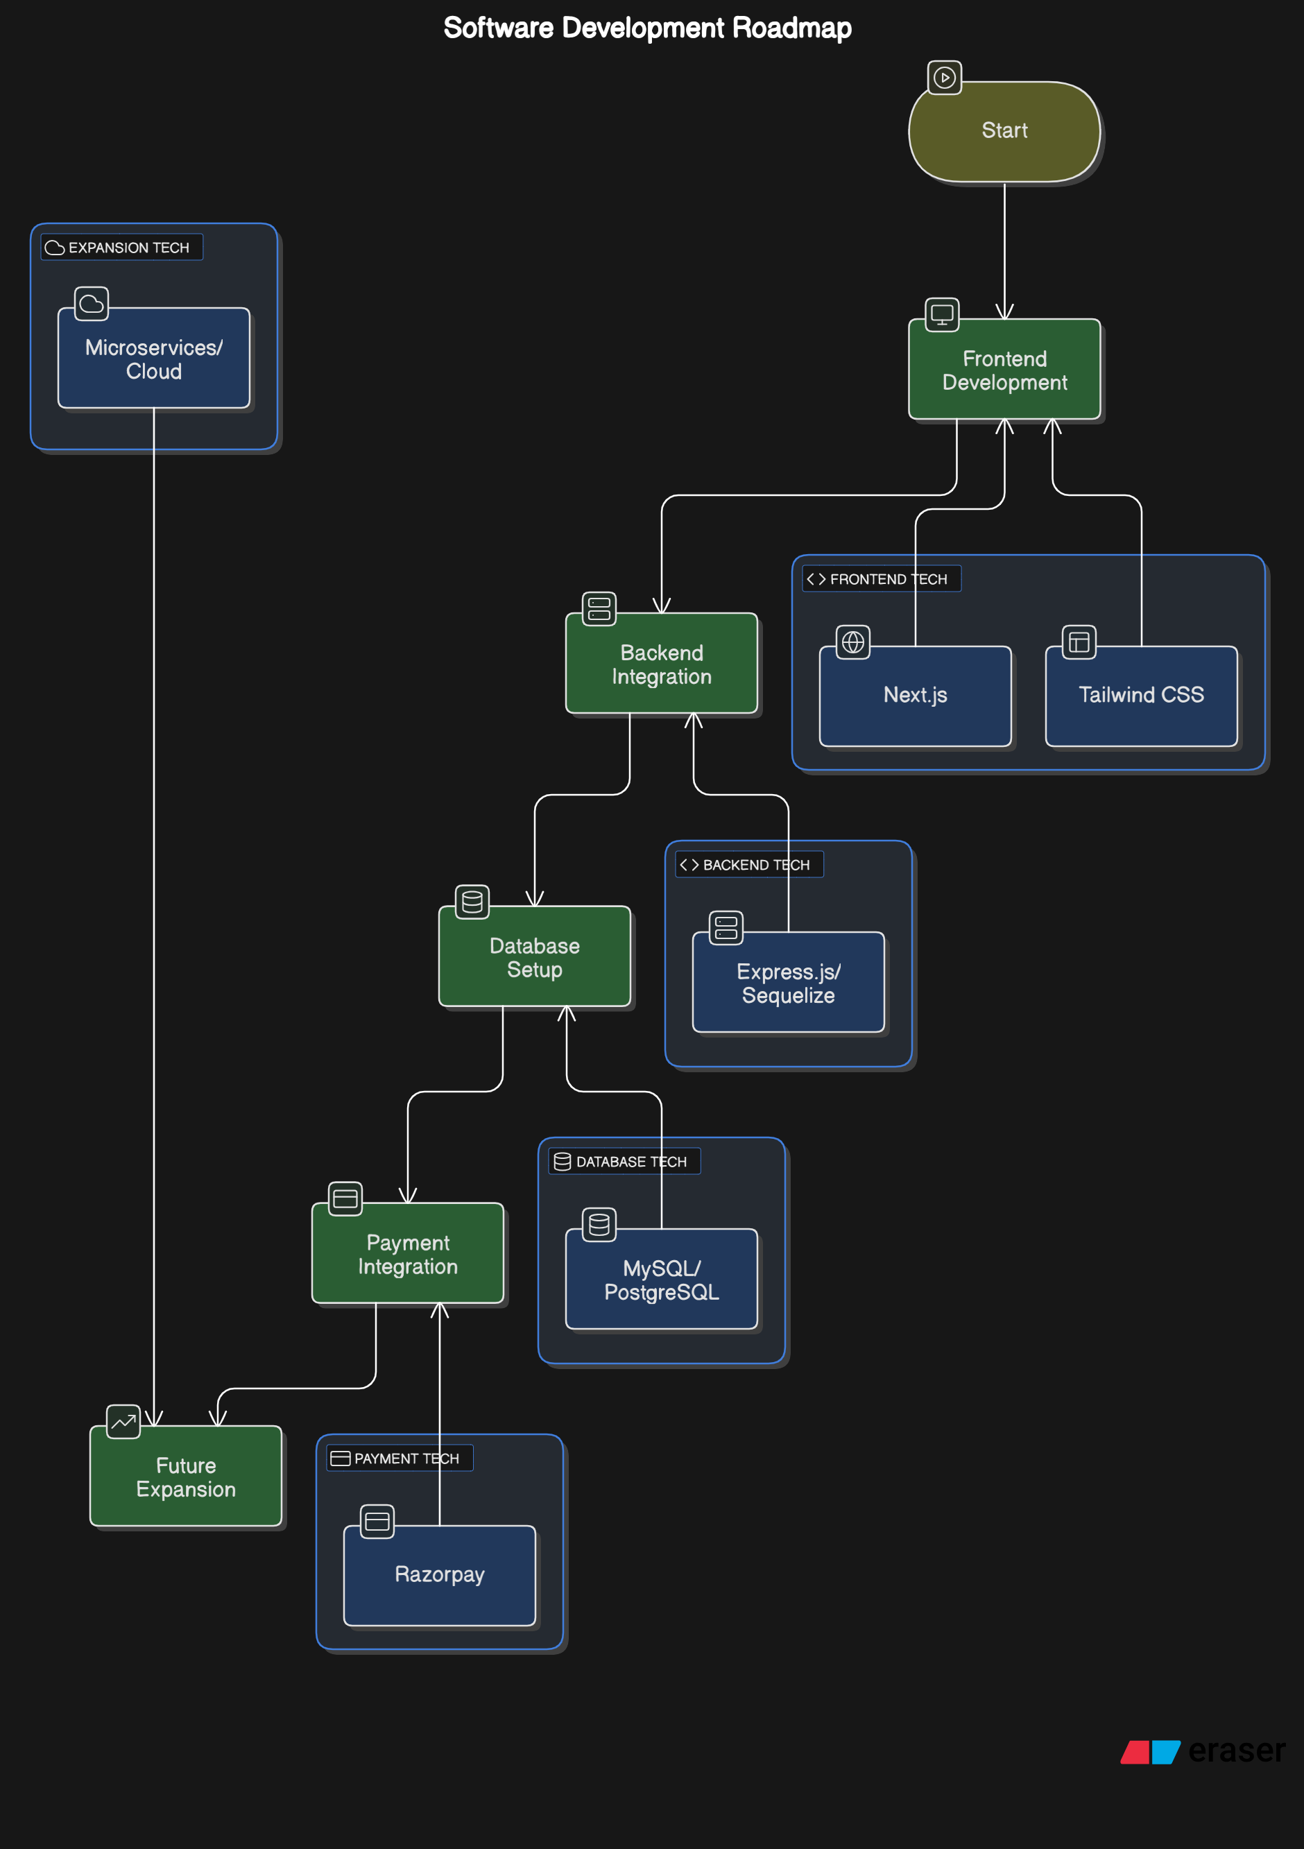
System Architecture

Slide 6
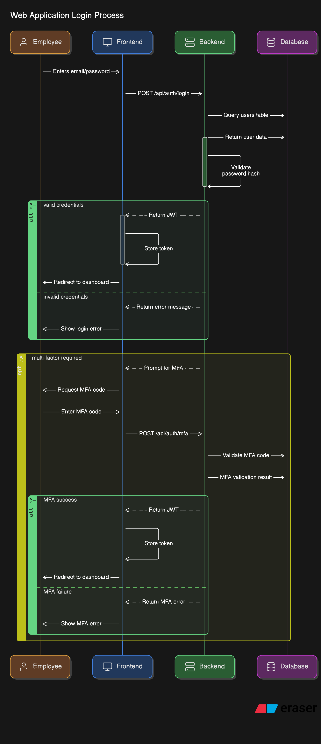
Employee Login Process

Slide 7
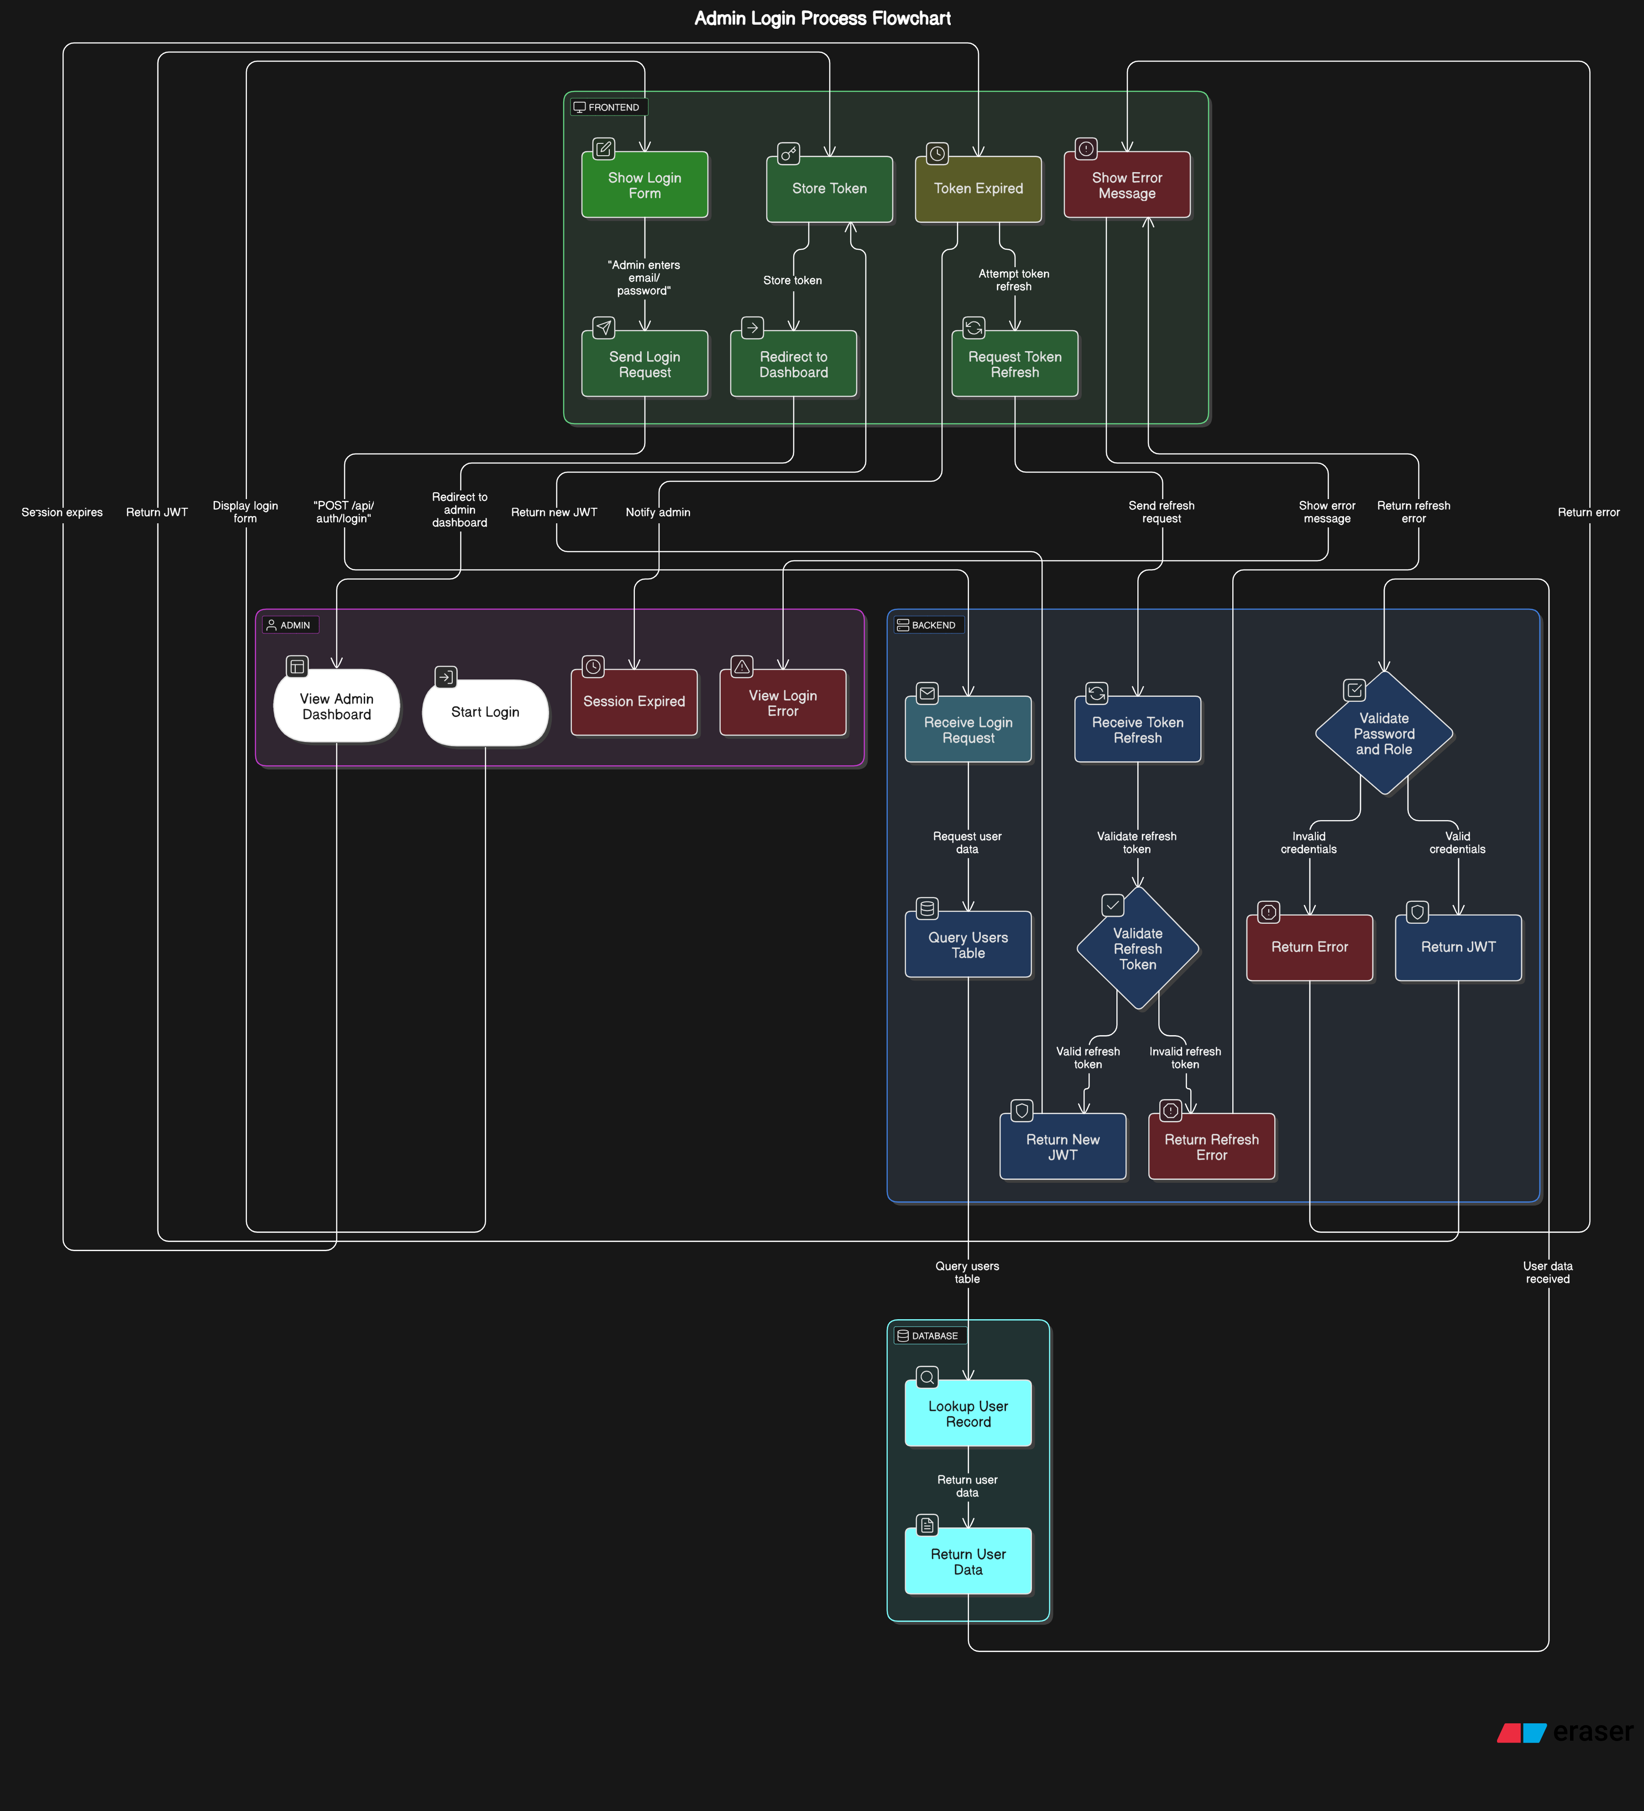
Admin Login Process

Slide 8
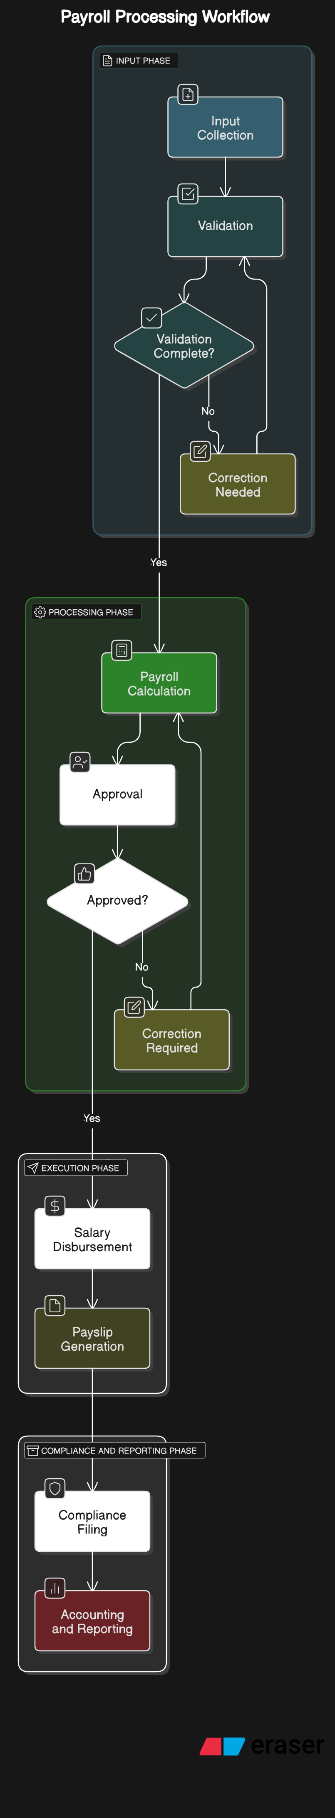
Simple Payroll Process

Slide 9
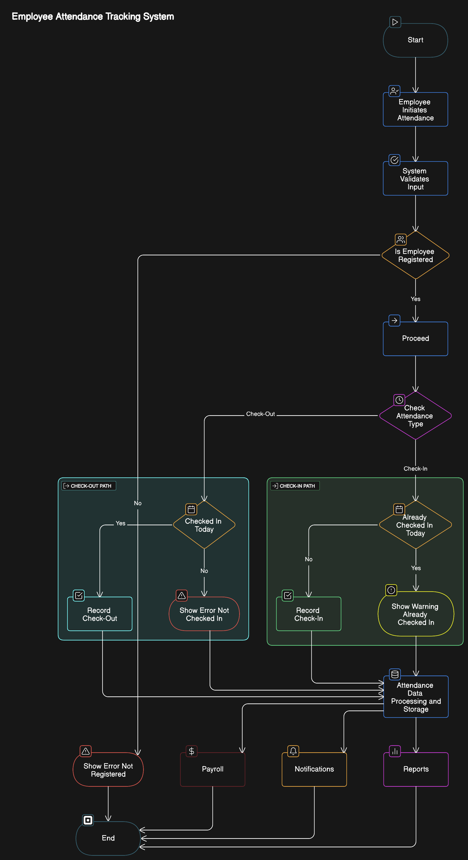
Attendance Tracking

Slide 10
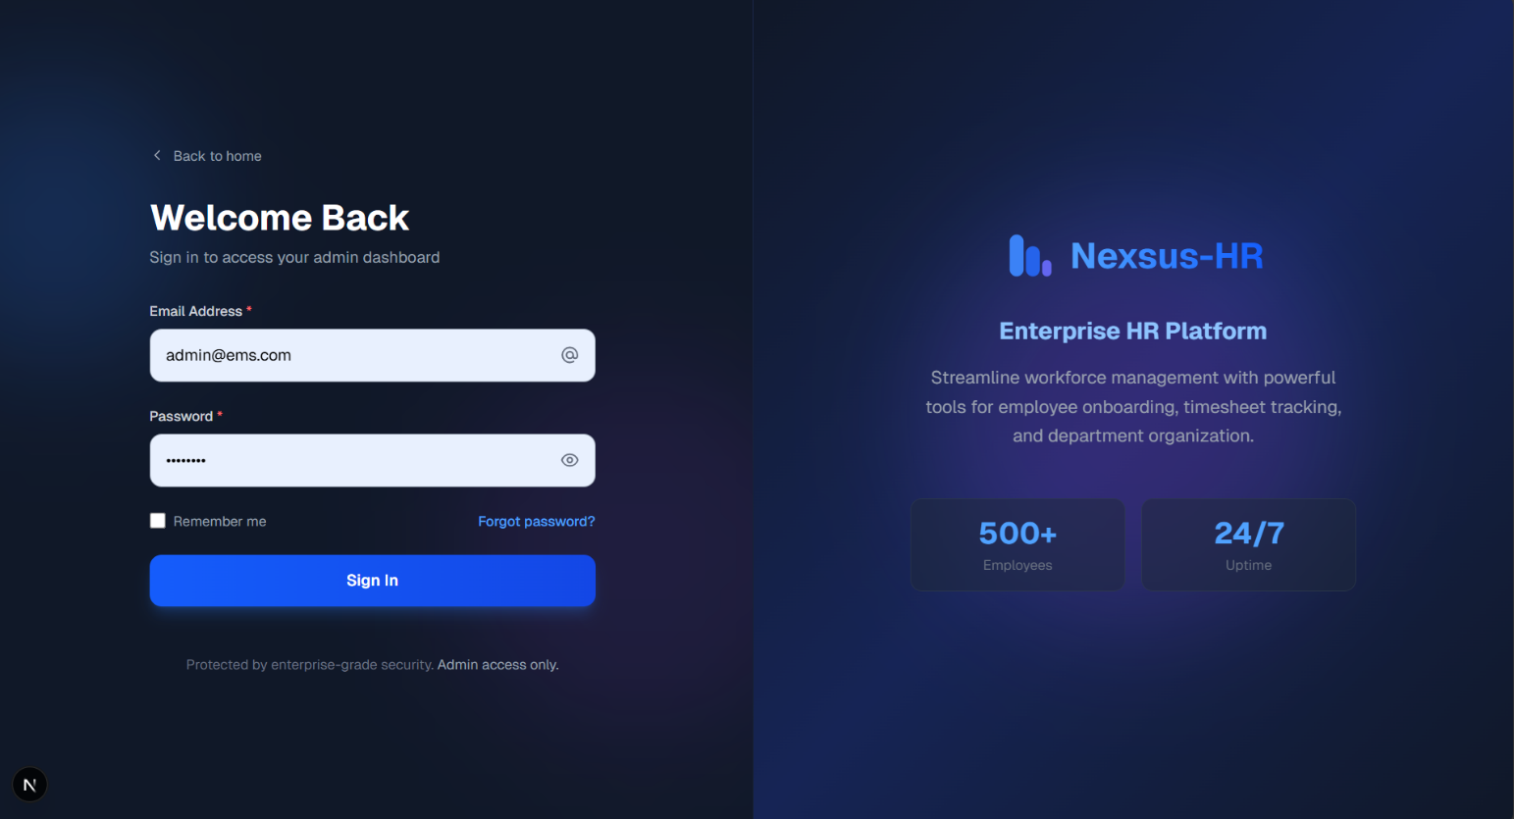
Project Screenshots: 1.Login as SuperAdmin/SubAdmin

Slide 11
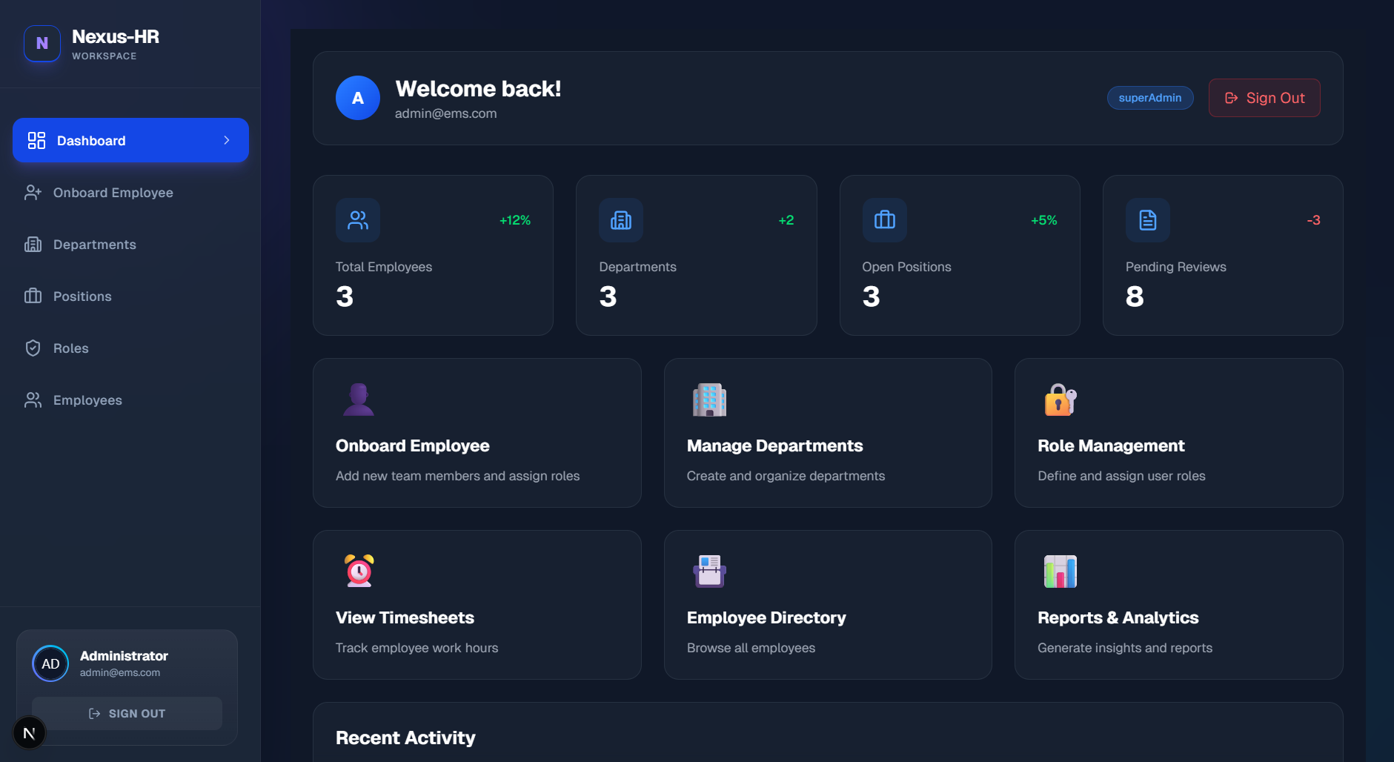
Project Screenshots: 2. Admin Dashboard

Slide 12
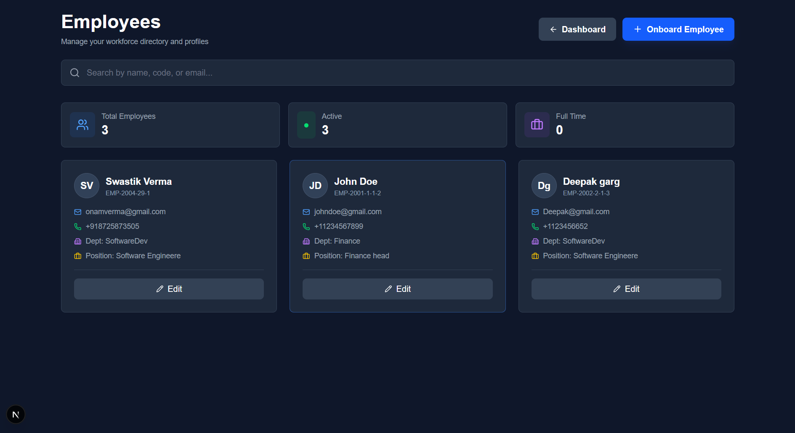
Project Screenshots: 2. Employee Dashboard

Slide 13
Future Scope
1. Smart Attendance System with Face Recognition & Geo-Fencing → Integrate webcam-based facial recognition using TensorFlow.js → Combine with GPS coordinates to ensure employee is at authorized location → Helps prevent proxy attendance and supports hybrid/remote
2. Built-in Real-time Chat & Announcements with Read Tracking
→ Add internal messaging system using Socket.io
→ Include “seen/unseen” status for transparency
→ Improves coordination across departments
3. Automated Document Generator (Salary Slips, Offer Letters, etc.) → Generate downloadable PDF documents dynamically using pdfkit → HR/Admin can auto-fill details from database templates with one click → Saves manual effort and standardizes official documentation processes

Slide 14
Conclusion
The Employee Management System will significantly enhance operational efficiency by automating employee record management, payroll processing, and leave tracking. It will improve employee satisfaction by providing easy access to personal information, salary details, and leave status through a user-friendly interface. The system will reduce administrative workload for HR teams by streamlining key processes and ensuring accuracy in data handling. Leveraging modern technologies will ensure scalability and adaptability, allowing the system to grow with the organization’s needs while maintaining high performance and reliability.

Slide 15
Thank You
15

